Slide 1
Local Government Division
Shelly Williams, Division Engineer

Slide 2
TAP – Transportation Alternatives Program
Matt VanAuken
TAP Coordinator
ODOT Local Government Division
mvanauken@odot.org
405-436-3734
Notes:
Primary intent -

Slide 3
Transportation Alternatives
Federal funds – must meet all federal aid requirements
Intent of program – transportation projects
Build complete streets
Safety for all users
Connectivity
Equitable on and off road networks
Eligibilities
Pedestrian and bicycle facilities
Overlooks and viewing areas
Community improvements (such as historic preservation)
Vegetation management
Environmental mitigation related to stormwater and habitat connectivity
Recreational trails
Safe routes to school
Vulnerable road user safety assessments.

Slide 4
Transportation Alternatives
Eligible Entities
Local Governments
Regional Transportation Authorities
Transit Agencies
Natural Resource or public lands agencies
School districts
Tribal governments
MPO serving less than 200,000 populations
Non-profit entity

Slide 5
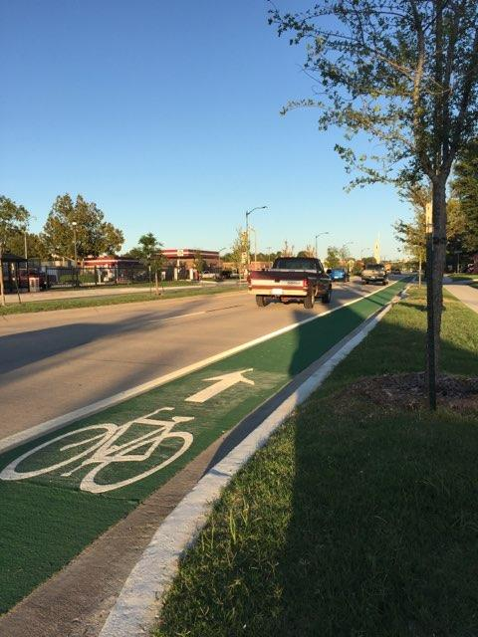
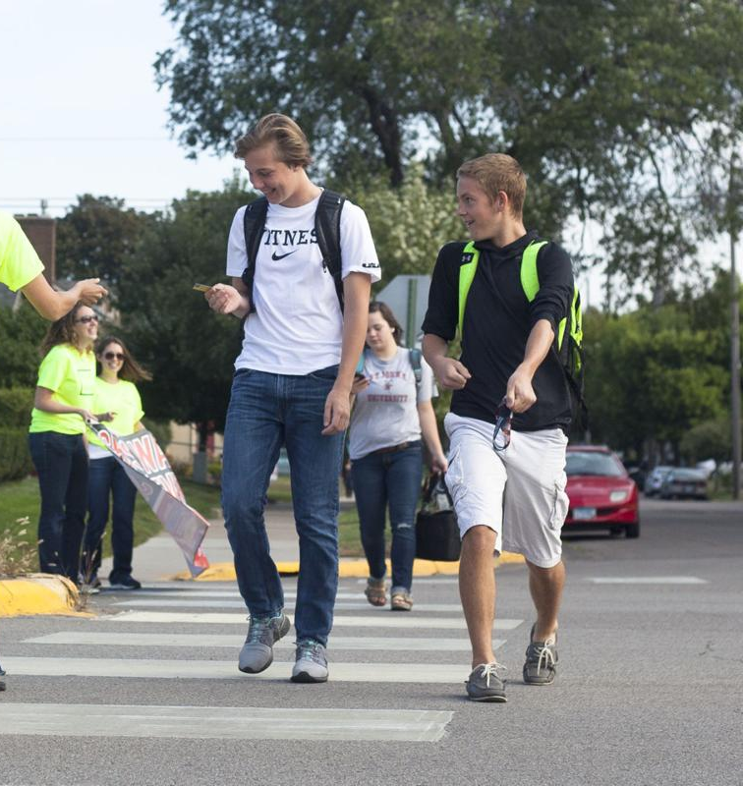
Transportation Alternative Program (TAP)
Funding provided through the IIJA-BIL
Safety Components of TAP
ADA compliant sidewalks and trails
Bicycle infrastructure
Pedestrian and bicycle signals
Traffic calming techniques
Streetscapes or Enhancements
Lighting and other safety related infrastructure

Slide 6
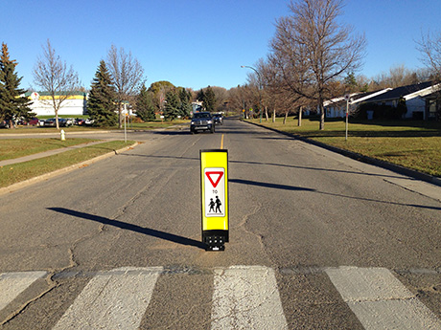
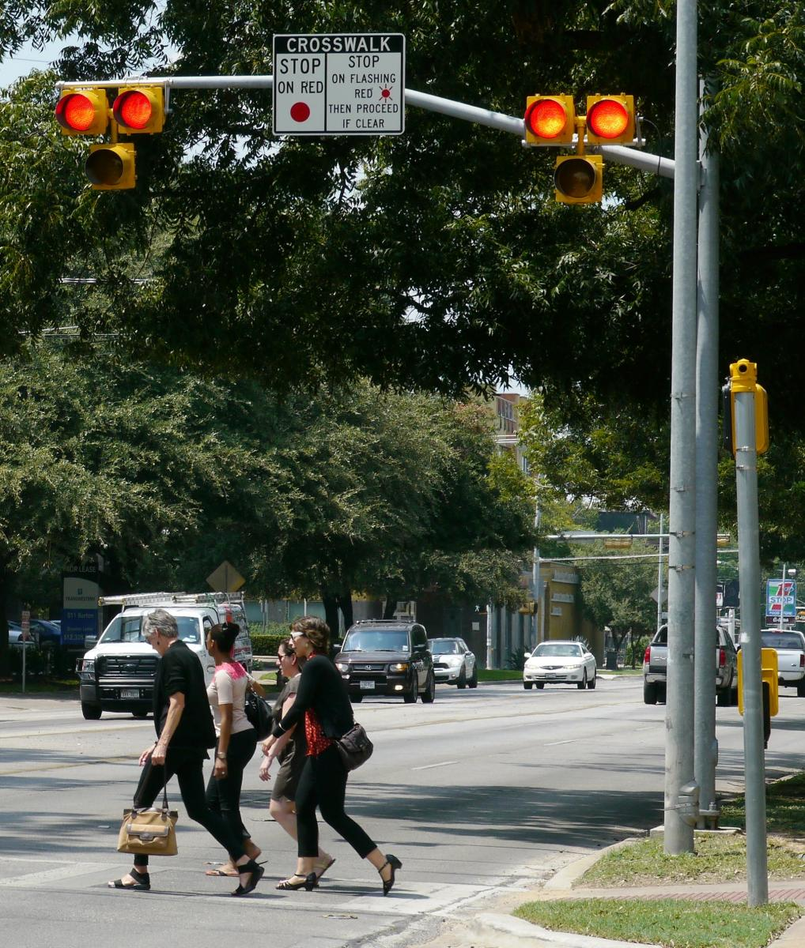
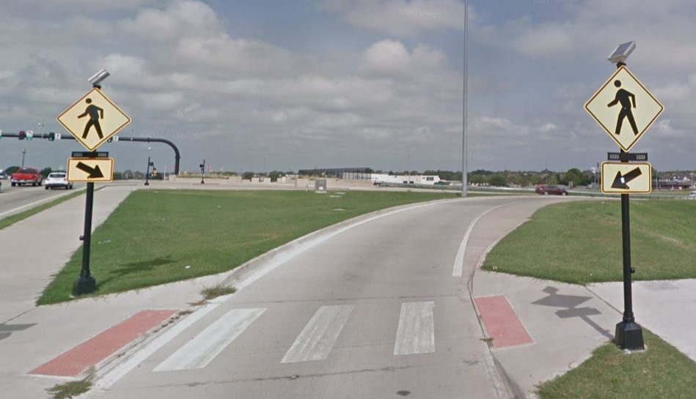
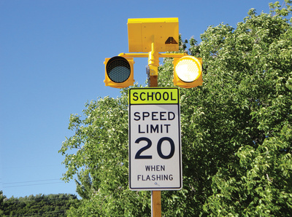
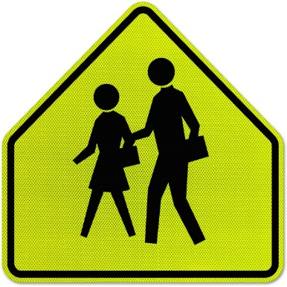
Typical Safety Improvements

Slide 7
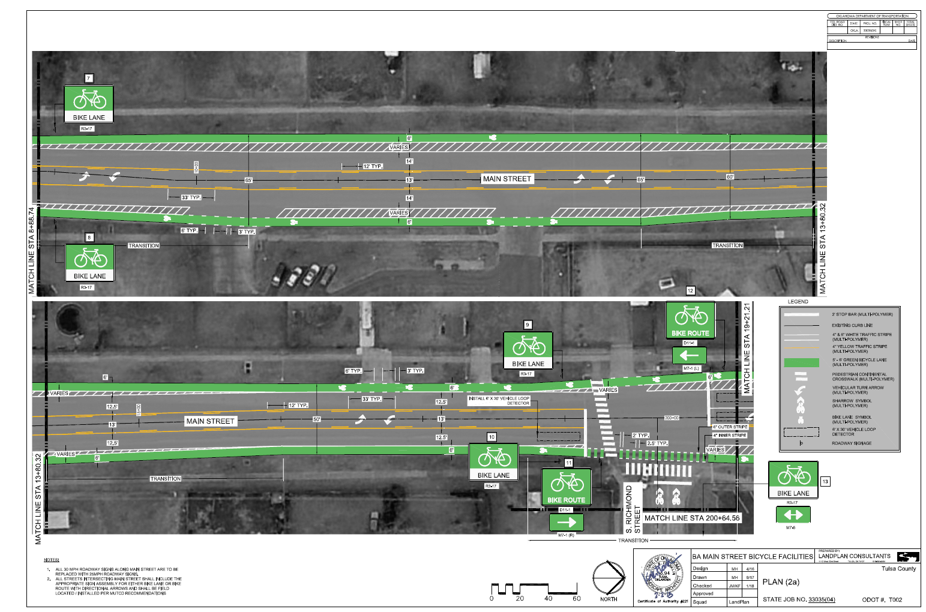
Bicycle Safety
And Road Diets
Also includes:
Off-road trails,
Rails to Trails
Vegetative Management
Stormwater Management

Slide 8
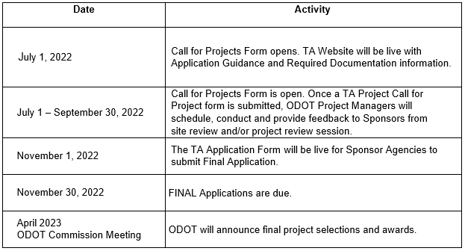
TAP PROCESS PRIOR TO AWARD
TAP Projects are Awarded Through a Competitive Application Process

Slide 9
TAP Funding
TA Set Aside - $22.3 million annually
April 2023 award will be $44.6 million
Over 200K | 50K-200K | 5K-50K | Less than 5K | Any Area | Total
$5,324,004 | $703,983 | $2,288,847 | $4,848,899 | $9,149,069 | $22,314,804
0-5K Category
100% Design
90/10% Construction Funding
Suggested project size less than $700K
All other categories
80/20% matching for construction and design
Overmatch encouraged
Suggested project size $1 million
ACOG/INCOG cities inside UZA boundaries can apply for statewide funding if < 20,000 population

Slide 10
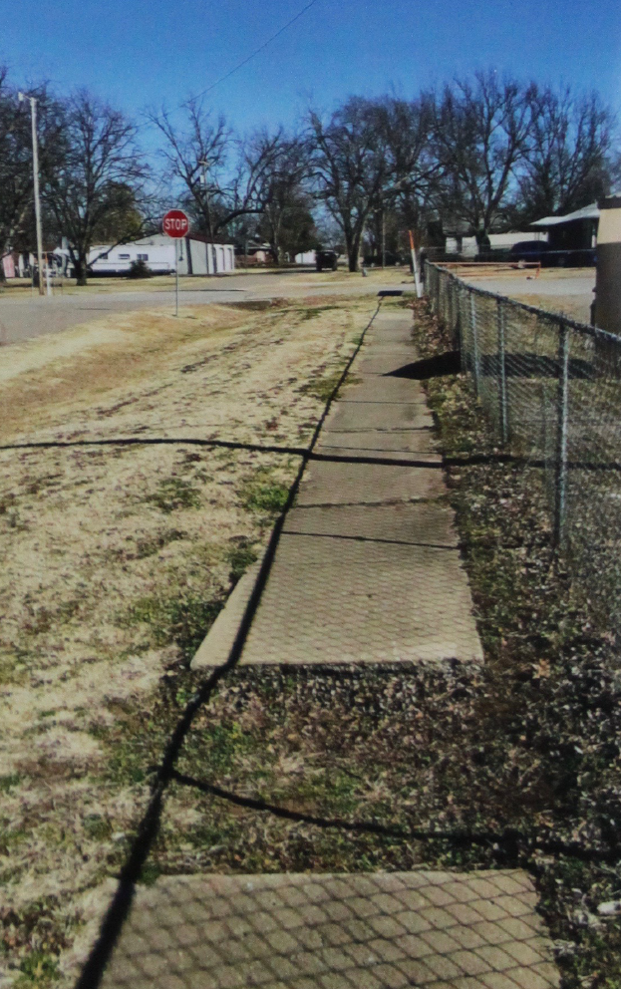
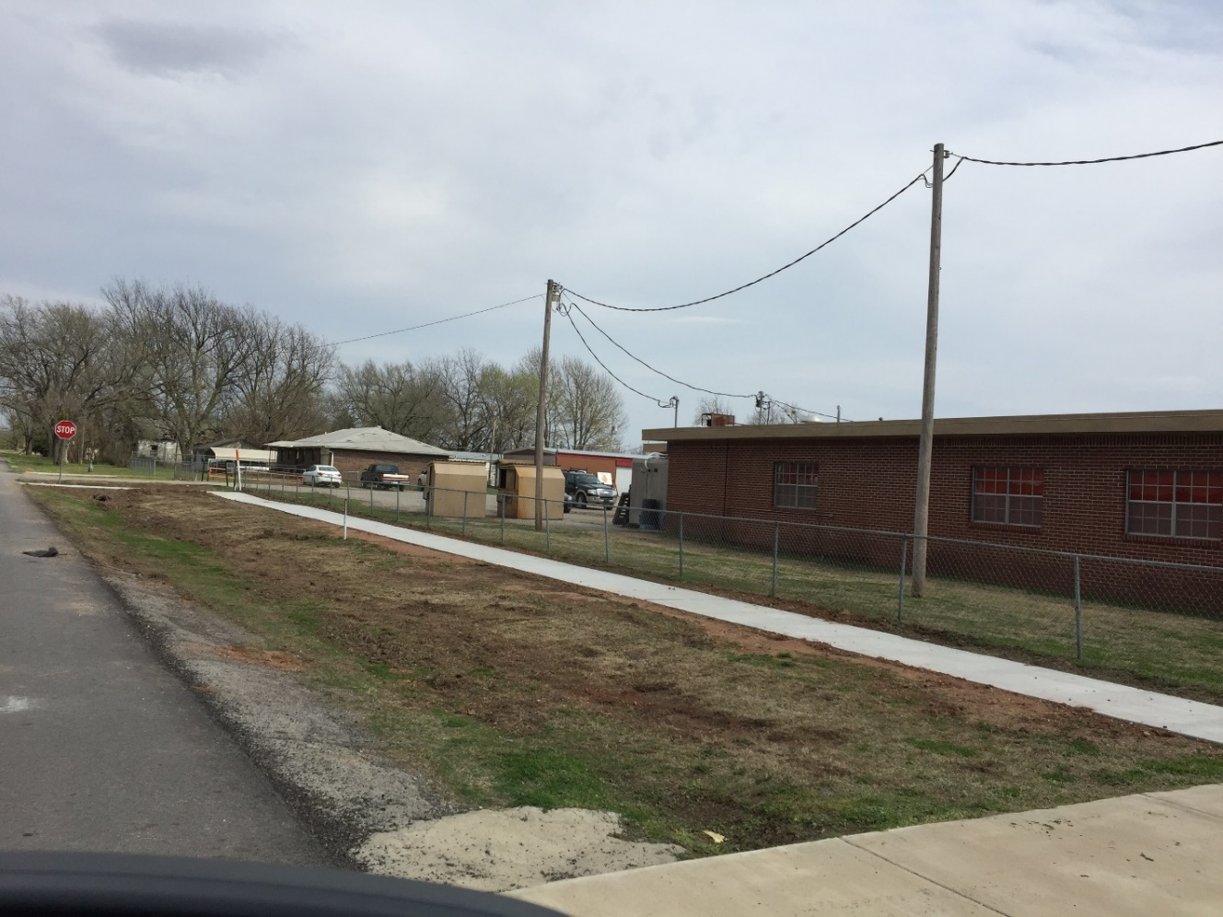
BEFORE AND AFTER

Slide 11
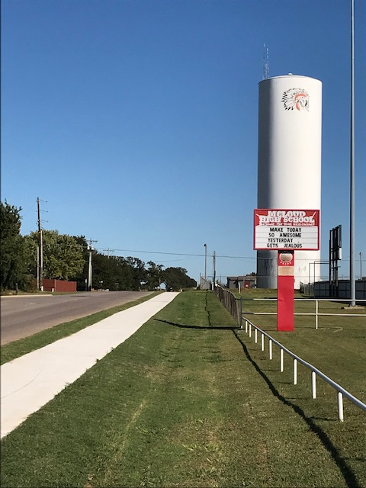
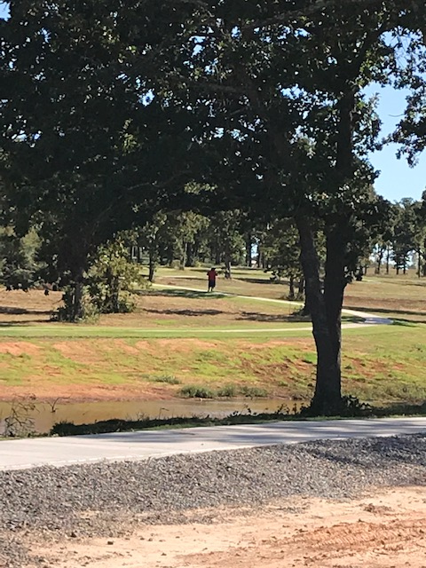
Community Pride – Downtown Revitalization – Safe Routes to Schools – Pedestrian Safety
Sponsor Responsibilities
ODOT Responsibilities
Right of Way Acquisition
Utility Relocation
Matching Funds
Maintenance of Facility
Design Contract Management
ODOT Bid Letting *
Environmental Clearance
Construction Inspection
Final Inspection and Audit
Notes:
Upcoming TAP applications likely in January. Based on upcoming transportation funding bill. Expect an increase from $6 million to $14.4 million.

Slide 12
Local Government Division - New
Bridge Formula Program – 100% federally funded
Scour Mitigation Program - $18 million annually
City SD Bridge Program - $10 million annually
HB3037 – 75% state/25% matching
Municipal Road Drilling Activity Revolving Fund - $5 million annually
Applications open – Local Government Resource Tab
Notes:
Total projects through Local Government Division is $168 - $180 million annually

Slide 13
Additional Information
ODOT Local Government Resource Tab
https://oklahoma.gov/odot/business-center/local-government-resource-center.html
Shelly Williams, PE
ODOT Local Government Division
405-208-3289
slwilliams@odot.org

