Slide 1
Chanler Cory
Northwest Mobility Manager
Chanler@noda-ok.org
405-763-7815

Slide 2
What is Mobility Management
It’s a strategic approach to transportation resources that focuses on:
Moving people instead of moving vehicles
Mobility management projects begin with a community vision in which the entire transportation network work together to deliver the transportation options that best meet the community's needs.
Plans for transit sustainability, strives for easy to find resources, educating the general public, and continually incorporates customer feedback as services are evaluated and adjusted.
Notes:
1.) I’ll explain that more thought the presentation but I am more focused on how people maneuver around the community. This is essential because transportation goes into something bigger than just vehicles and busses. This Is about saving the mental health and physical health of people.
Isolation with older adults is an issue
Connecting with new people for individuals of all ages is important for mental health
Getting people to doctors appointments
Etc..
2.) I am continuously thinking about ALL of the transportation providers in the area
How can I make them better
How can I help them
How can I bring them all together to provide different options to meet community needs
3.) Listening to the public and advocating for more resources

Slide 3
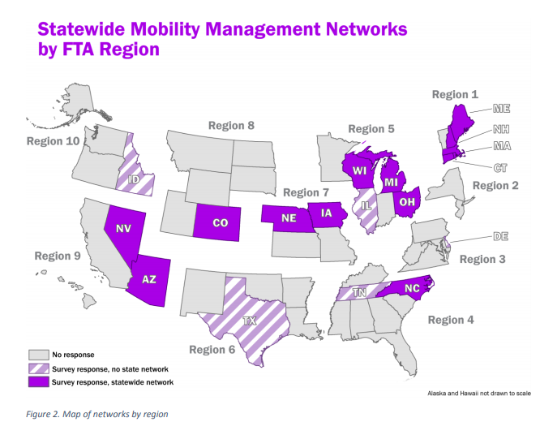
MOBILITY MANAGEMENT IN THE NATION
Notes:
This program can be placed in multiple agencies and that we are looking to place this program in a variety of different agencies to expand statewide.
Cristi is just getting started and will be gathering data/ building her network/ building relationship with the community.

Slide 4
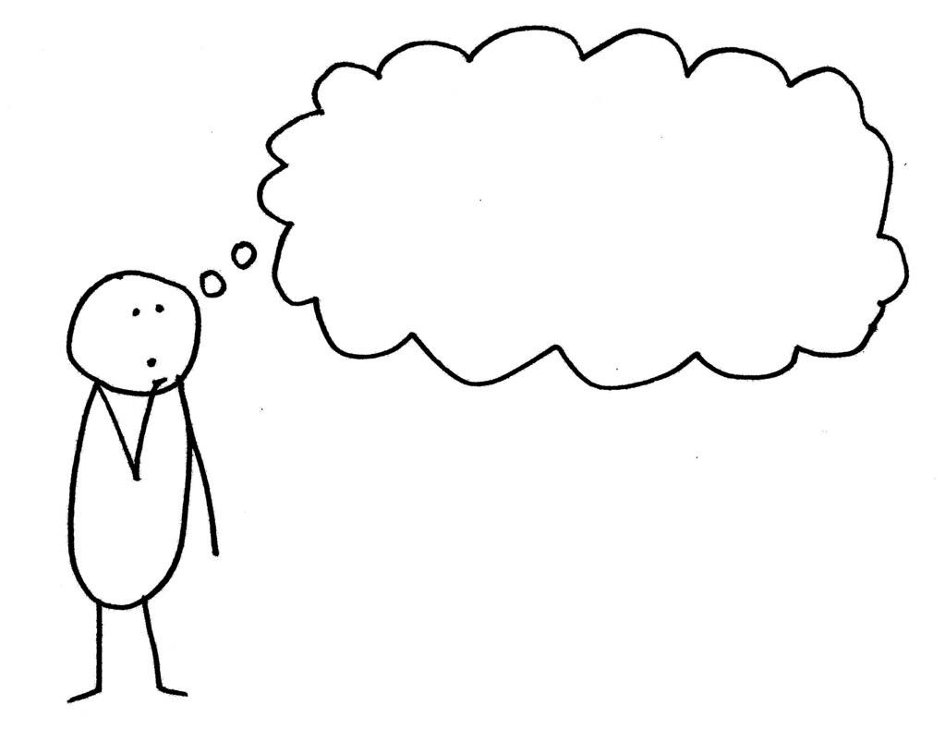
What does a Mobility Manager do?
Mobility Managers:
Understand and Navigate
Coordinate and Collaborate
Inform and Connect
Launch and Sustain
What does that mean…
Notes:
I am a Social worker for transportation --- the easiest way to think about it.
A lot of times I am the middle man is the process of helping people. -- I listen to the people I serve and find a solution to their transportation problems.
If there isn’t a solution, its my job to make one through projects and advocacy.

Slide 5
Key roles for mobility management professionals: Understand and Advocate
To effectively plan a responsive and sustainable transportation network for all Oklahomans, empathy and an unbiased understanding of their needs, environment, and goals is essential
Conducting data collection activities to understand transportation needs, uncover resources, communicate the benefits and impact of public transit.
Promote transportation equity, accessibility and mobility for all.
Encourage human service agencies to provide client transportation through public transit systems for safety and cost-efficiency.
Notes:
There is a strong emphasis on listening to my local community, conducting ongoing needs assessments, and designing services and programs to fit the identified needs.
Mobility management begins and ends with a laser focus on transportation's many client groups. -- current and potential riders, employers, economic development groups, local business associations, human service agencies and their clients, taxpayers and other funders, and local governments.
I do this to effectively plan a responsive and sustainable transportation network for all these customers.
Empathy and an unbiased understanding of their needs, environment, and goals is essential.
Being able to articulate this relationship between transportation and success in other sectors is an important step in strengthening support for community transportation options.

Slide 6
Key roles for mobility management professionals: Coordination and Collaboration
Mobility Management practitioners cultivate partnerships and collaborate efforts throughout transit agencies, planners, and other community stakeholders.
Attending community meetings to discuss transportation options. This includes making transportation a consideration in discussions for new developments, shopping centers, housing developments, employment centers, food banks, and medical facilities during the planning stages.
Participating in other planning efforts (for example: workforce development, health needs, education, etc.).
Educate health and human agency staff, workforce agency staff, policymakers, elected officials, and other stakeholders on impact of transit and other transportation services and on the need for new or expanded mobility options.
Notes:
The Coordinated plans are underway!
What does this mean??
The coordinated plan is a 4 year plan that lays out the guidelines for the needs in our community.
People need more access to prenatal care…. Put it in the plan
People need a bus that runs the same route all day.. Put it in the plan.
This is a tie for you to be involved in the conversation.
We all know there is a need for more transportation. Its hard as social workers to know a client needs counseling and consistent doctor visits but---
we have no way to make the treatment come full circle because we cant get them there in order to get the help they need.
I will be contacting you all about the public meetings we are going to hold so that you have a seat at the table.

Slide 7
Key roles for mobility management professionals: Inform and Connect
Produce publications about all the available transit and other transportation options in the community:
Resource guides
Program websites and social media
Presentations to community groups
Attendance at community events
Human interest stories
Newsletters
Annual reports
Provide information to human service agencies and other agency staff on transportation service options.
All mobility management activities point toward one goal: connecting customers to the transportation options that are most responsive to their needs.
Notes:
This goes for your services as well. Lots of time people call me and more often than not – as you all know – the solution is not a one size fits all. Most of the time people need more resources than just transportation. That’s when I connect and inform the client about your services. So I need to be educated on your programs as well.

Slide 8
Key roles for mobility management professionals: Launch and Sustain
1. Develop strategies with the regional transit network, the regional mobility plan will include goals and objectives for mobility management services.
Coordinate strategic steps to ensure project launch is successful and sustainable:
2. test assumptions about what will work and why.
3. Re-examine, the service's desirability, feasibility, and viability.
4. Plan for sustainability of the service.
5. Identify opportunities to coordinate service delivery to close gaps or eliminate overlaps.
Notes:
The regional mobility plan--- the coordinated plan
2.
3. -------- test and test again to make sure the solution works. We do this through surveys, public meetings, and OVER ALL handing over the decision to the public
4. -------- put it in the plan so its eligible for funding
5.-------- Implement the plan to close gaps and satisfy the needs that put the project into play in the first place.
LAST and FOREVER -------- Inform and connect
Let the public know what the solution ( the project) is and how to use it.
Then we start over -------- Understand and advocate, coordinate and collaborate, inform and connect, launch and sustain

Slide 9
A day in the life of a Mobility Manager:
Work with transportation providers to help them meet riders’ needs and encourage them to coordinate with each other
Advocate to policymakers on the importance of community transportation, mobility, and access
Help individuals plan trips and arrange rides
Help people get where they need to go, using all transportation resources in a community.
Refer people to other resources if needed
Always gaining knowledge about a variety of transportation services in the area.
As well as other institutions that need transportation
Notes:
I am boots on the ground talking to Influential groups like you all and making sure your needs are met as stake holders. I am responsible for making sure that people are heard when it comes to transportation. Thus making sure the mobility management program is successful.

Slide 10
Mobility Management is Different from Traditional Transit Coordination in several ways
Traditional transit planning addresses issues through improving transit system routes and services
Traditional transit coverage typically uses a single operator to deliver all services
Traditional transit generally focus on the direct provision of services
MM focuses on moving people and not just vehicles
MM focuses on diversity of multiple transportation providers to offer the most efficient service to individuals.
MM underscores the importance of service advocacy to improve transportation management and delivery.
Notes:
---- they are thinking ore about how their vehicles operate, If they need potholes fixed in their regular roads, how long they need to be open
I think about issues people are having weather that is with the transit system directly or if it’s a mobility issue
A transit agency is only able to control their services and their services only.
I am able to look at all of the transits in my area and see if we can coordinate them together if needed.
Transit continuously want to make their services better
I am here to advocate for improvement on a wider scale.

Slide 11
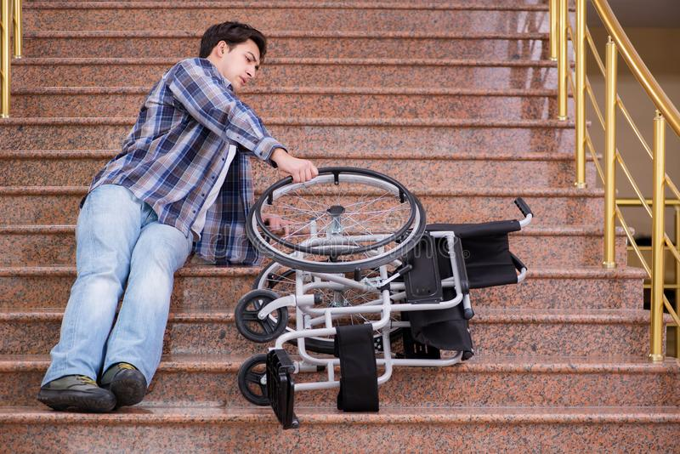
Mobility is Not Just Transportation
Bryan is a current passenger who lived in an apartment complex that was not wheelchair accessible
On a transit route
Bryan was having to scoot down the stairs & walkway, while the bus driver carried his wheelchair.
Barrier to mobility
Whose problem, is it?
Apartment management?
Bryan?
In the meantime, Bryan pays an emotionally & physical price every day he cannot get around
Transit Agency?
City or County Government?
Answer: No solid answer and bottom line-Nothing was getting done
Bryan is now able to get himself to the bus
Local Mobility Network
The mobility manager contacted the non-profit agencies and foundations in the area and found that the Kiwanis Club had a program for this need.
The MM collaborated with Bryan, the Kiwanis Club and the apartment manager on the issue all agreeing on the steps to make the apartment complex a better place for mobility.
The Kiwanis Club installed the wheelchair ramp free of charge.
Proactive Planning
The MM tasked all drivers to communicate wheelchair ramp needs from riders for a community restoration project.
Also, the wheelchair ramp is now a community offering when assessing an individual's access to mobility. The mobility manager has local support for other individuals who need a wheelchair ramp installed

Slide 12
Engaging with the program on a local level
Invite the MM to visit your agency to understand all services and resources
Include the MM in community meetings and working groups
Share the Program
Any program brochures, flyers, etc. can be given to the MM to pass along to residents
Participate in local mobility meetings
Share transportation struggles & brainstorm solutions
Partner on a transportation solution project
With those who need mobility management
People, communities, providers

Slide 13
Questions?
Contact:
Chanler Cory
Northwest Mobility Manager
chanler@noda-ok.org
405-763-7815
Cristi Williams
Southwest Mobility Manager
Cristi@swoda.org
580-562-5058 or 580-660-5035

