Slide 1
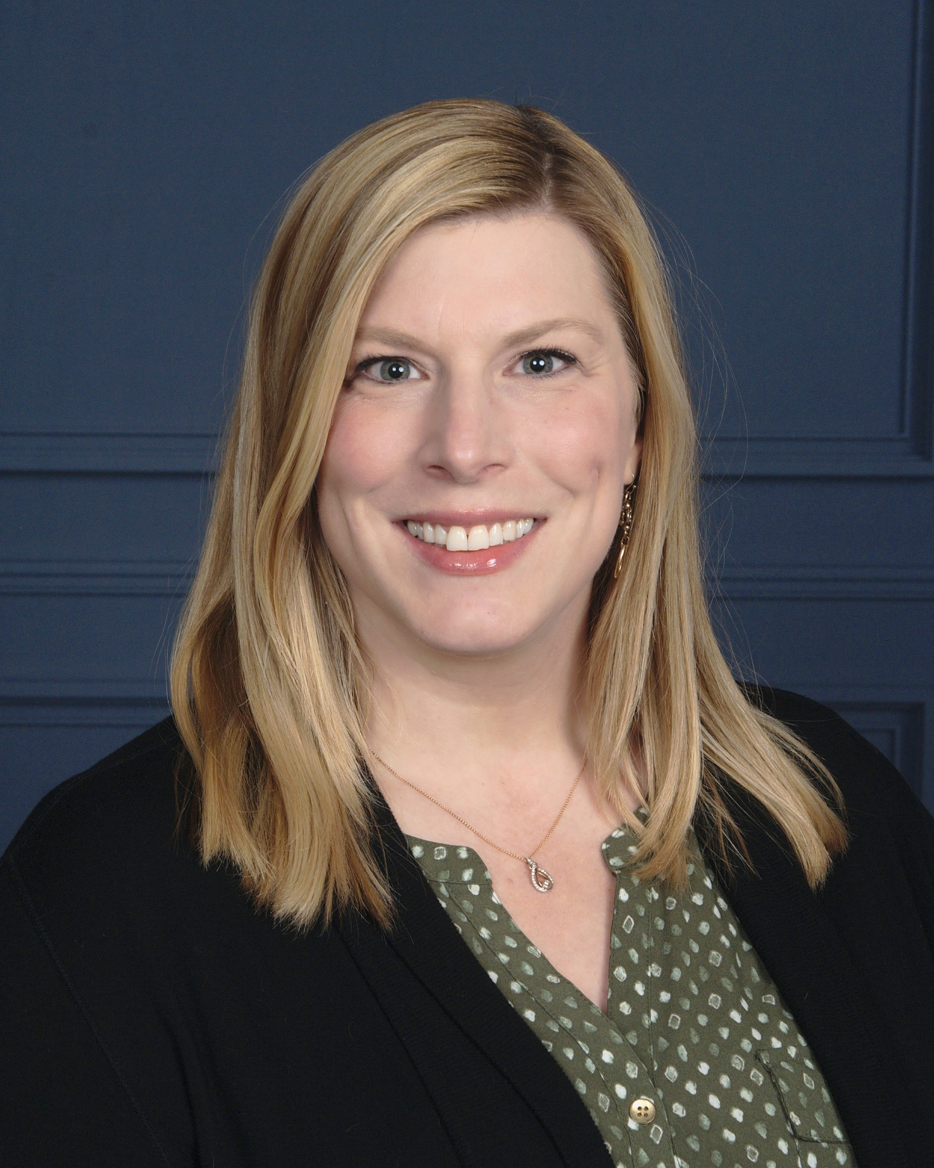
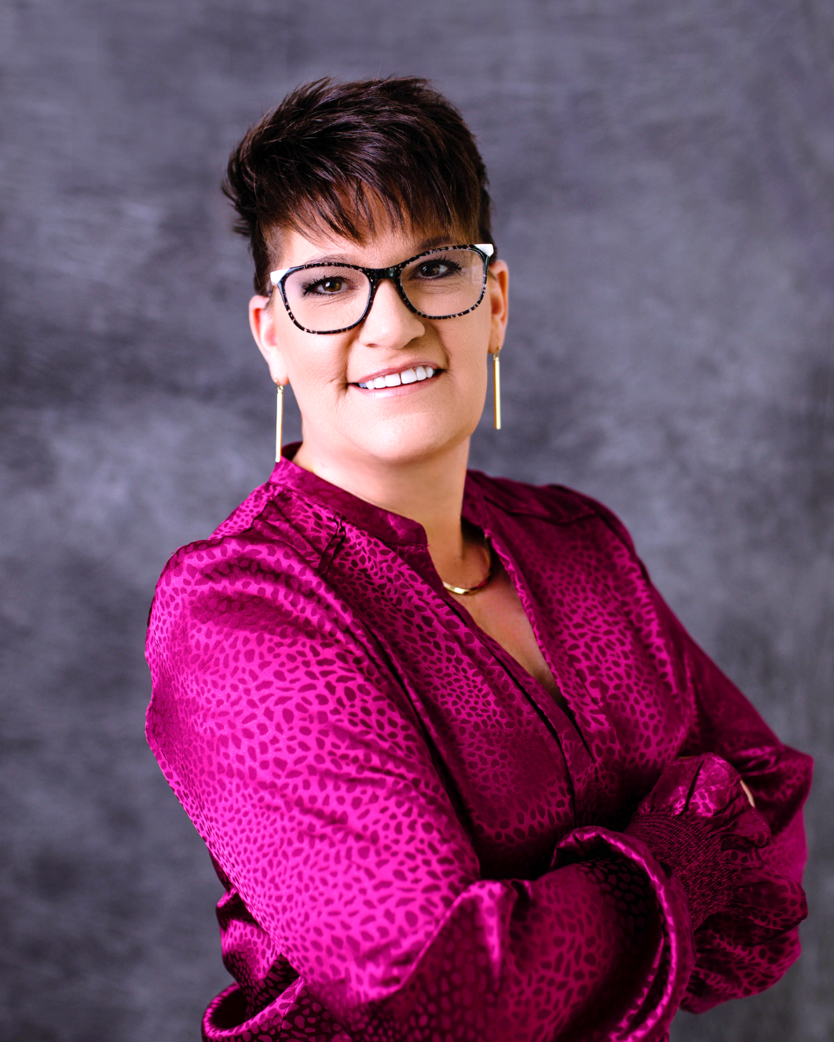
Oklahoma
Mobility Management
Olivia Hook
Transportation Manager
Oklahoma Department of Transportation
Cristi Williams
Mobility Navigator
South Western Oklahoma Development Authority
Notes:
Oklahoma did a peer study in 2020 identifying that Oklahoma needs a mobility management program. I was one of the peer states in the study and I was given the opportunity to build mobility management together with new programs that launched in 2023.

Slide 2
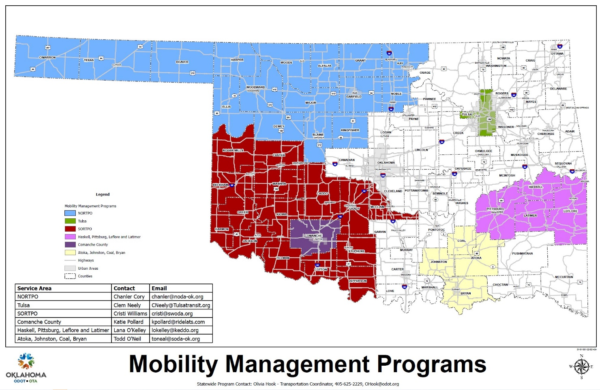
Established in 2023, Oklahoma currently has 6 mobility management programs
Goal to serve 100% of OK w/ no gaps in mobility management support
Currently at 58% coverage serving 45 out of 77 counties
77% of counties in OK will be served by mobility management programs by the end of 2024
Less confusion for individuals/agencies to find mobility management
Statewide branding
We have been growing fast!!!

Slide 3
How we have been building our mobility network
We invest in relationships—because we cannot do anything without them
Transportation Providers
Community Service Agencies & Non-Profits
State Agencies
Related Programs
5307, 5311, Tribal, 5310, etc.
988 mental health transportation services
VA transportation
Sooneride/NEMT brokerage
They are not just attending our coordination meetings- we show up at their offices, local committees, planning efforts and community assessments as representatives in mobility. And we keep coming back to the table to participate, support and collaborate solutions together.
State agencies meet with our statewide mobility contact to discuss high-level transportation projects, opportunities to become involved, partner or support transportation providers efforts (including rural areas).
Our next step is starting CCAM discussions with state agencies matching them up with coordinated project efforts that match the CCAM grant opp.
Communicate with mobility managers for less critical mobility needs
Same- veterans don’t just need medical transportation and there are some needs the VA cannot meet- but mobility managers can help find those solutions.
OK has a statewide brokerage model
Added MCO’s in 2024

Slide 4
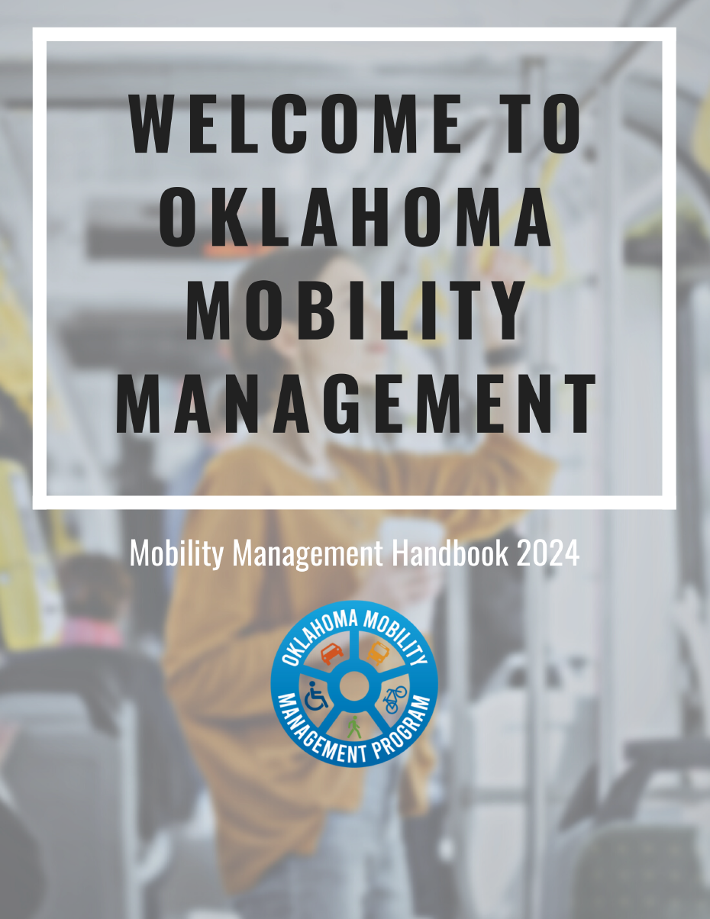
And we work together a lot
The result, when you contact one of us, you’re getting support from all Oklahoma mobility managers.
Mobility managers communicate issues and address challenges as a team, so that no mobility manager is left in the dark to handle challenges on their own.
Mobility Management Meetings
Quarterly Roundtables
Other meetings
ODOT 5310 & 5311 monthly grant meetings
Weekly Mondays
Weekly Wednesday Workshops
Training, open discussion, FAQ’s
Share updates and announcements
Training
Peer support & collaboration
Regional coordination task force meetings
RTPO/MPO meetings
Community meetings

Slide 5
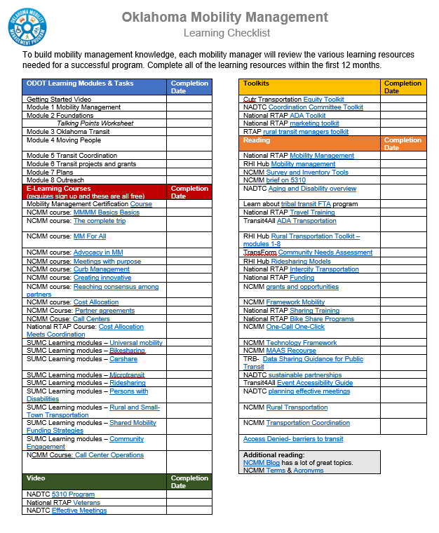
We’re building up our knowledge
Rather than spending the next 1-2 years struggling to figure it all out, we have a structure.
TA center training
NCMM
National RTAP
And many others
Core Oklahoma Knowledge
Technical onboarding with ODOT
Mentor Program
Mobility managers building up new mobility managers with best practices
State-specific info that is critical to a successful mobility management program include:
OK Transit 101
Who are the transit agencies in OK and why do they operate the way they do
The big picture when it comes to mobility management in OK (what our role is as MM’s)
Types of transportation plans in OK and what that means for MM’s
Foundations and funding resources in OK & beyond
State agencies and programs that work with transportation
Project management task lists
Ability to easily partner with another mobility manager on tasks
Performance reporting comes from these tasks lists
Collaboration and documentation all on one platform

Slide 6
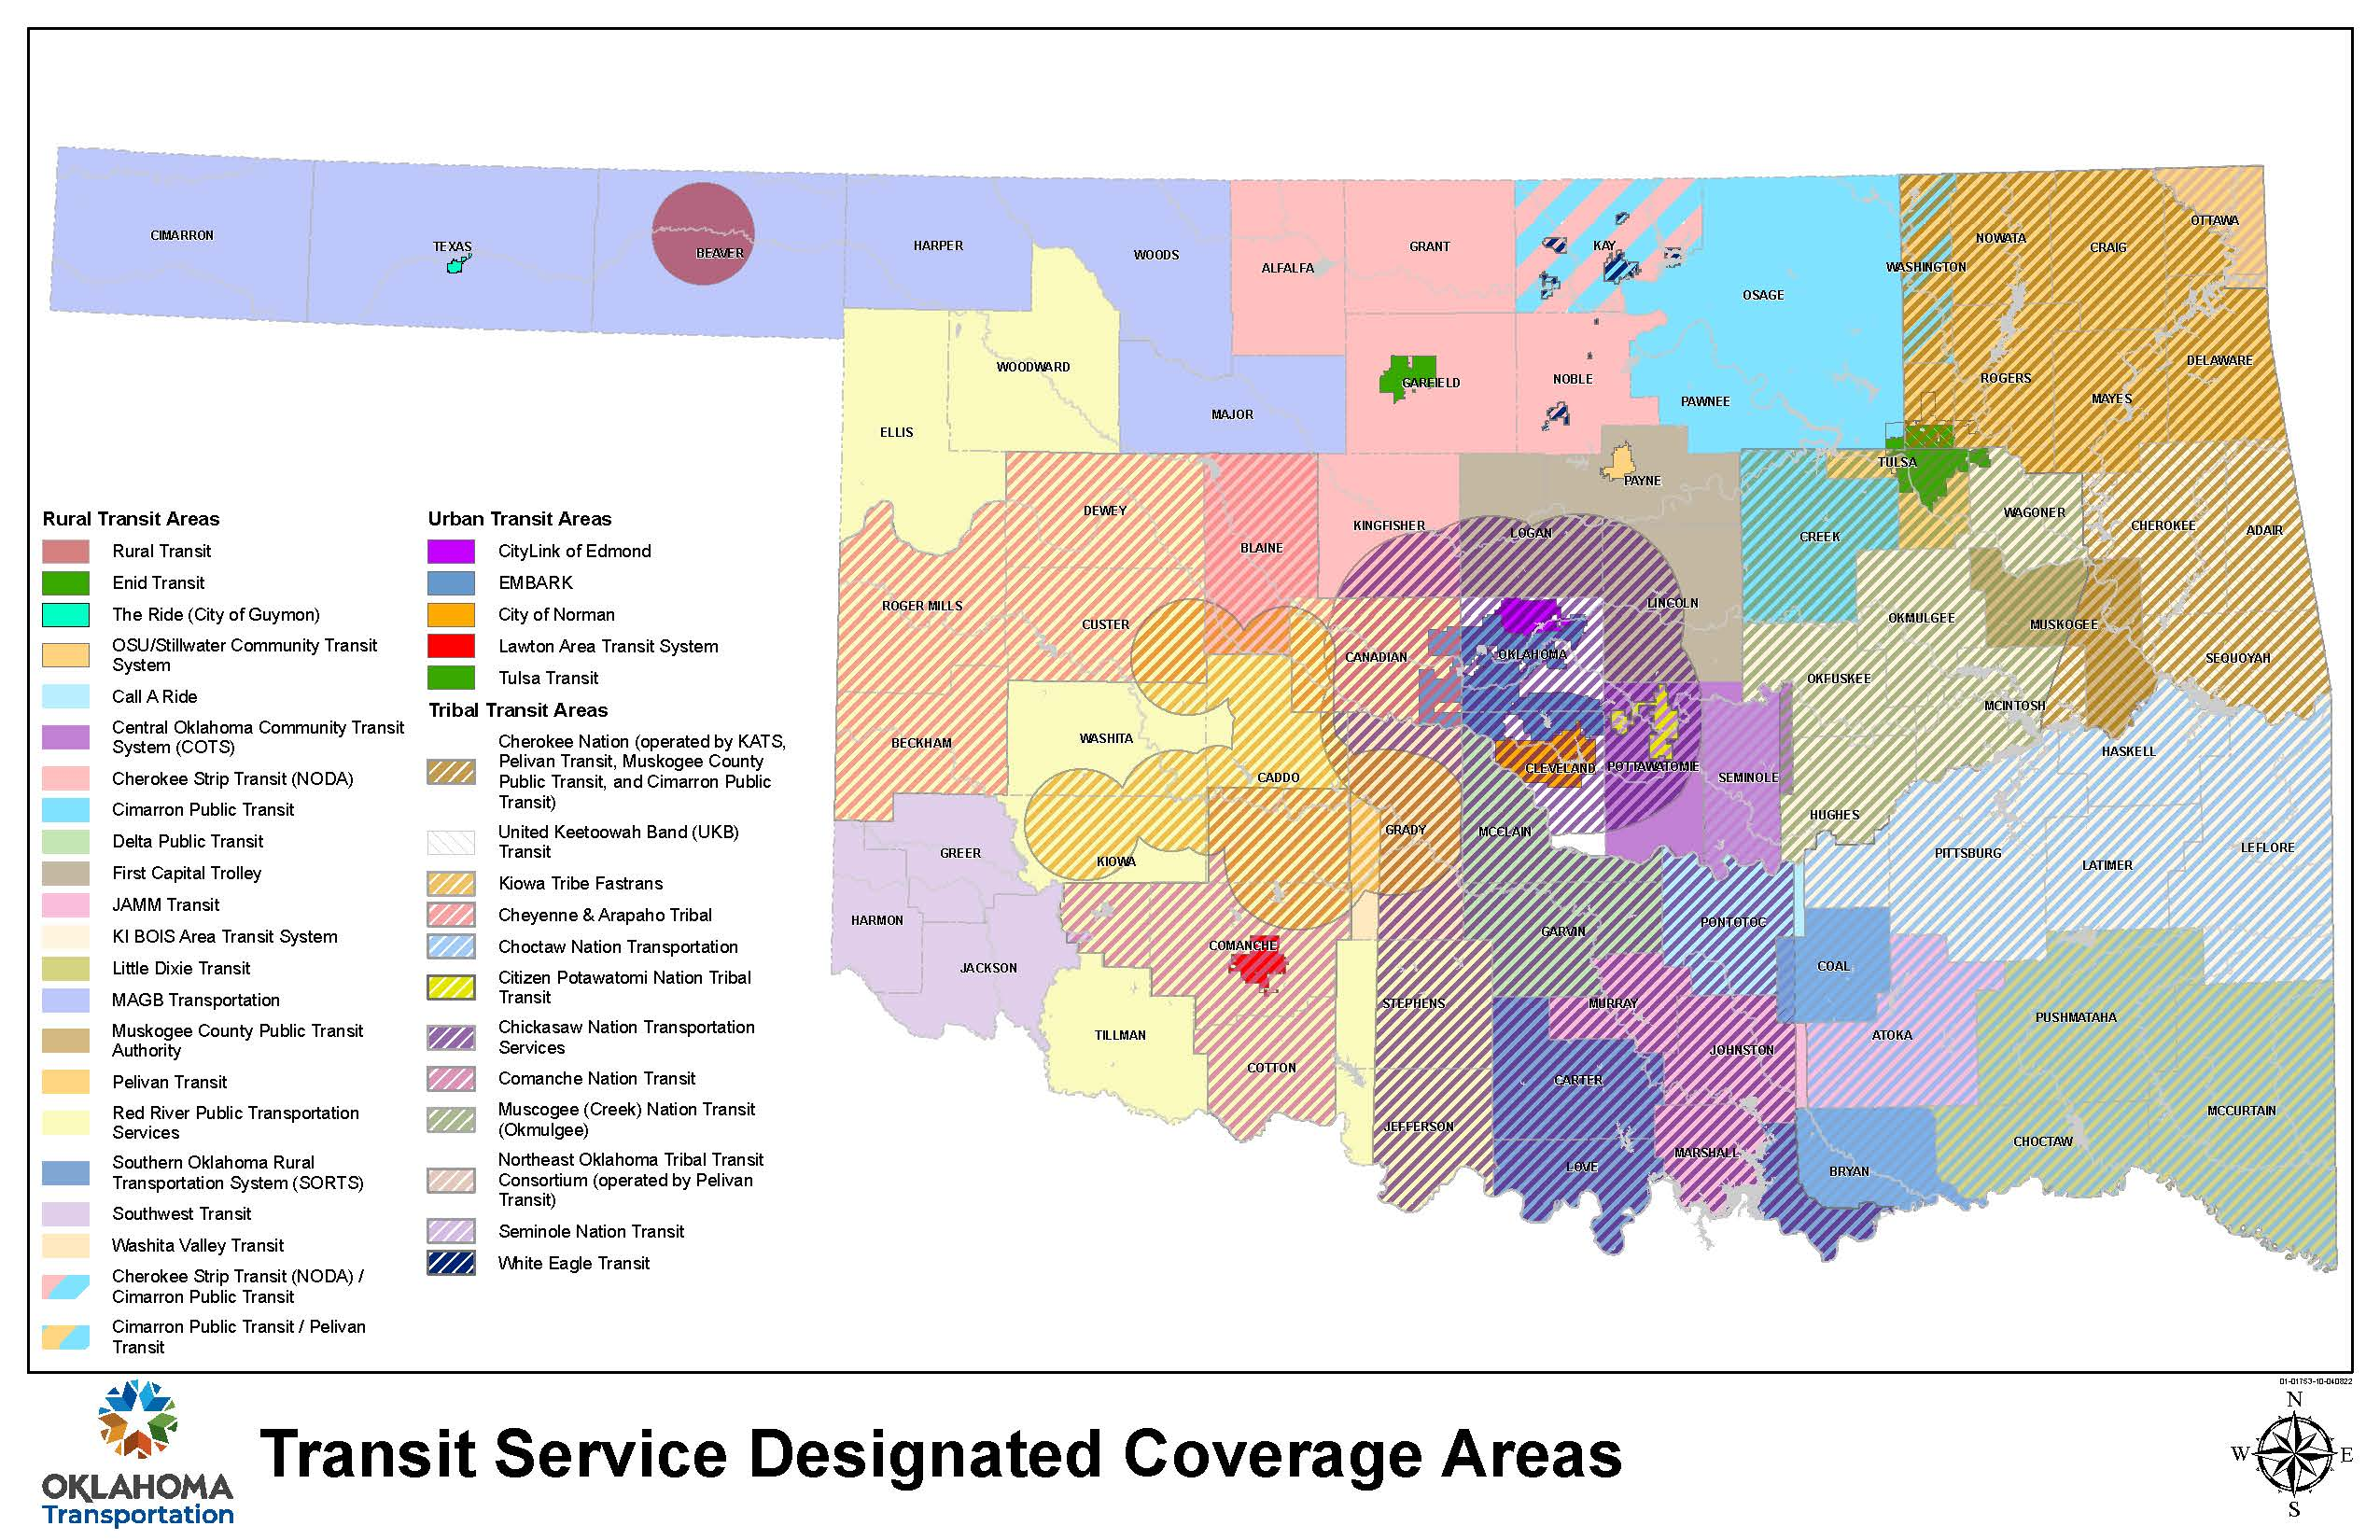
Why are we working so hard? Because Transportation is Complicated
Mobility managers can identify the gaps in service that maps don’t show
Mobility management is not just a transportation program. It's a program that can eliminate the gaps between transportation and all other community services.

Slide 7
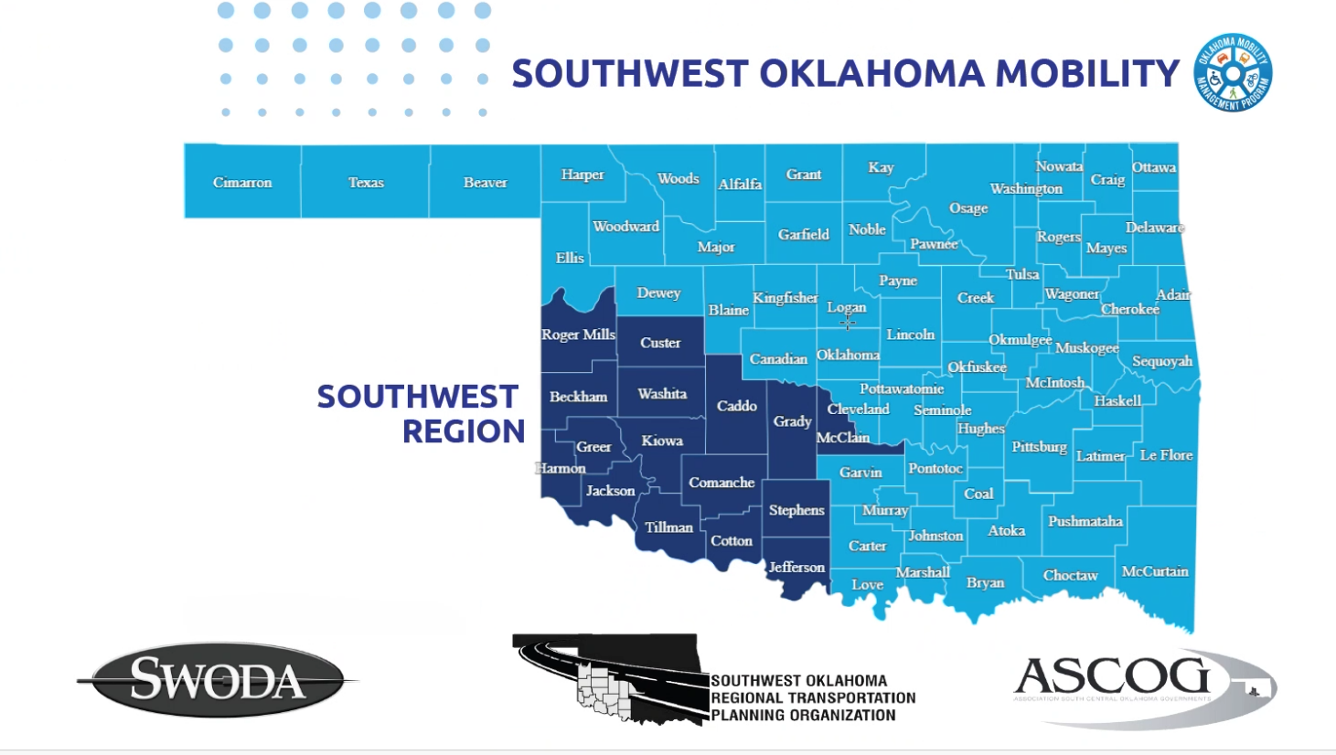
Highlights from the SW Region
Cristi Williams

Slide 8
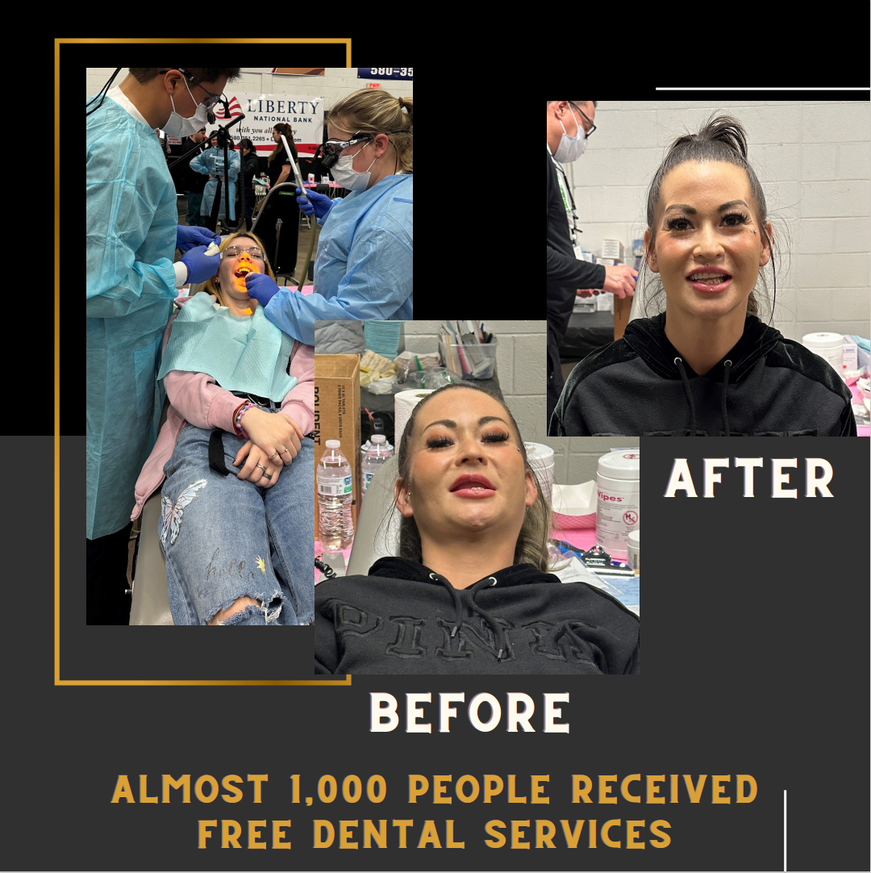
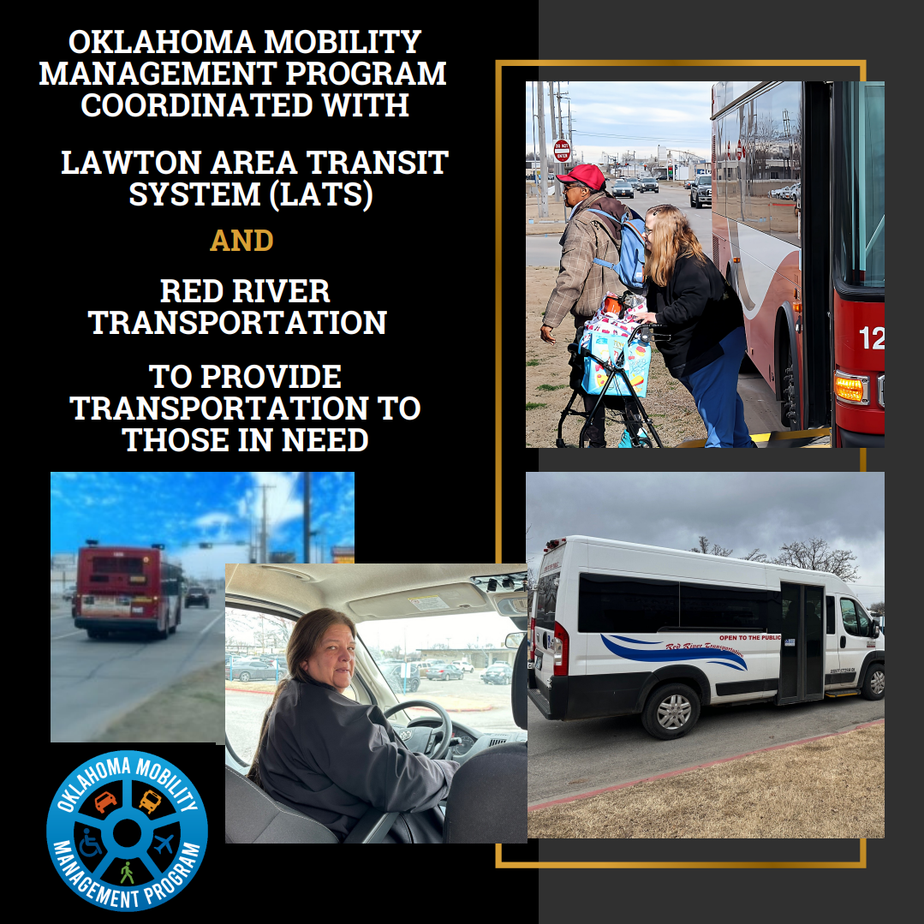
Highlights- Lawton OKMOM event
Collaboration = Success
Very little participation at Shawnee last year
Multiple groups sharing information about Lawton event - had to turn people away at 11:00am on the final day.
Oklahoma Mission of Mercy
FREE Dental Event

Slide 9
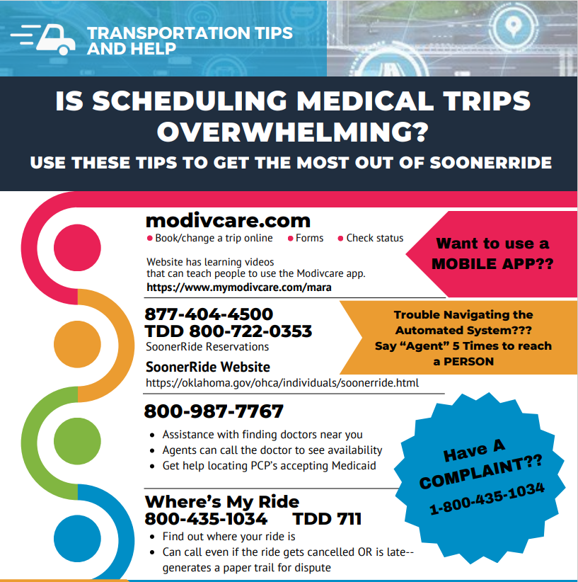
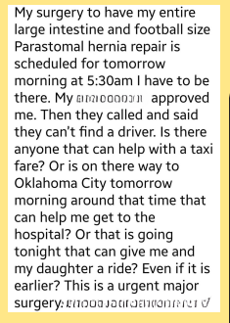
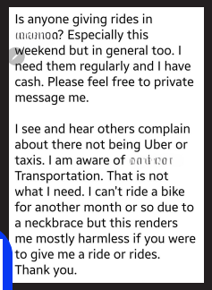
Highlights- Sooneride NEMT
SoonerRide/Modivcare/Ok Healthcare Authority
Client/Health worker with frustrations navigating the automated system, dropped rides and denied rides
Mobility navigator shared the issue
Contacts were made to bring Modivcare and Oklahoma Healthcare authority to meetings
Results:
Direct contact numbers to the Oklahoma Healthcare Authority for those assisting clients
Quick reference flyer for clients with basic numbers to contact and steps to navigate SoonerRide
Direct line to Modivcare for those assisting clients
Training for organizations on SoonerRide.
Positive Examples:
Rides denied by SoonerRide because of mileage restrictions are now being covered
Healthcare and Transit Agencies sharing Mobility Management information with clients
Actual Facebook Post
Actual Facebook Post

Slide 10
Highlights- Veterans Assist
Mobility Navigator received a call from a case manager in Lawton. Veteran spouse needed not only the transportation, but also an escort to travel with her. The cost, however, would be more than the veteran spouse could afford.
The home care agency told the mobility navigator about a veteran assist program. This program would pay for services; however, the application process would be completed after the veteran spouse's upcoming appointments.
Mobility navigator reached out to multiple people within the military community in Lawton. Organizations and individuals came forward to pay for her transportation or take her to her upcoming appointments.
Client was overwhelmed by the support and extremely grateful to all that came forward within the community to assist.

Slide 11
Highlights- Transportation Chat A Community Forum
The Mobility Management Programs
in Northwest and Southwest Oklahoma have begun talking with the community about transportation needs, concerns and strategies for improvement.
This chat is important because it brings the community together to discuss and focus on transportation issues and solutions that work for everyone.
Thus, ensuring that the solutions are efficient and consider the needs of citizens, businesses, organizations, and transit agencies.

Slide 12
Contact Page
And, we're just getting started
Olivia Hook
Transportation Manager
Oklahoma DOT
ohook@odot.org
405-625-2229
Cristi Williams
Southwest Mobility Navigator
Southwestern Oklahoma Development Association
cristi@swoda.org
580-562-5038
Thank you!!

